Slide 1
BCCA figures
March 13 2025

Slide 2
Data % to report
X2.1.Flow.Type n prop
<chr> <int> <dbl>
1 Biotic 113 0.551
2 Human movement 21 0.102
3 Physical 38 0.185
4 Sociocultural 33 0.161

Slide 3
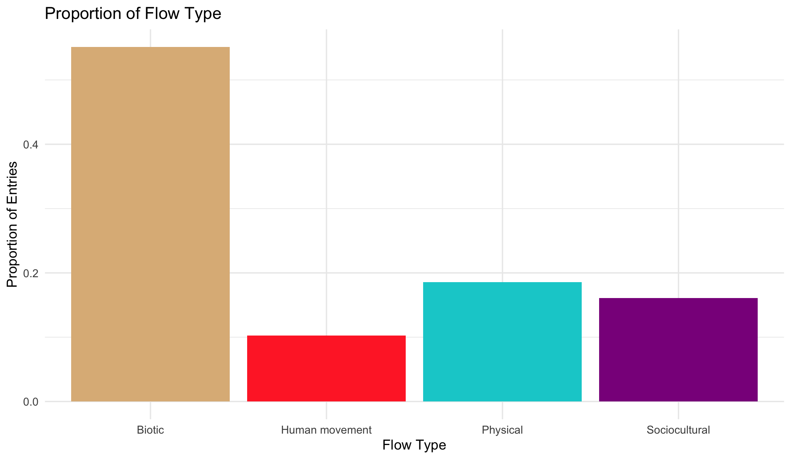

Slide 4
Multiple flows
Another.Flow. n prop
1 No 168 0.820
2 Yes 37 0.180

Slide 5
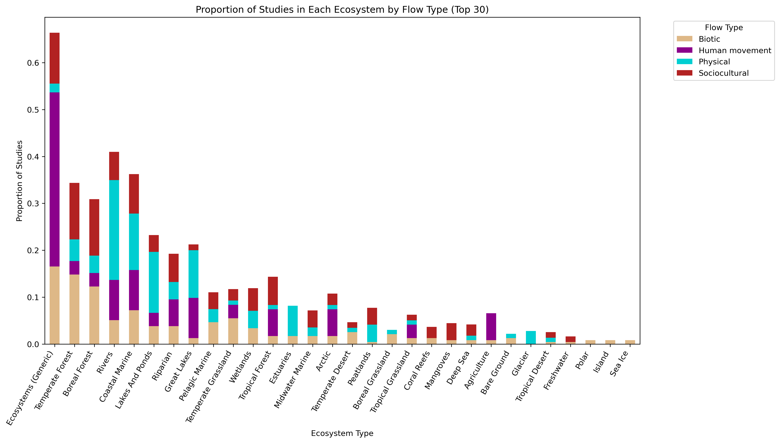
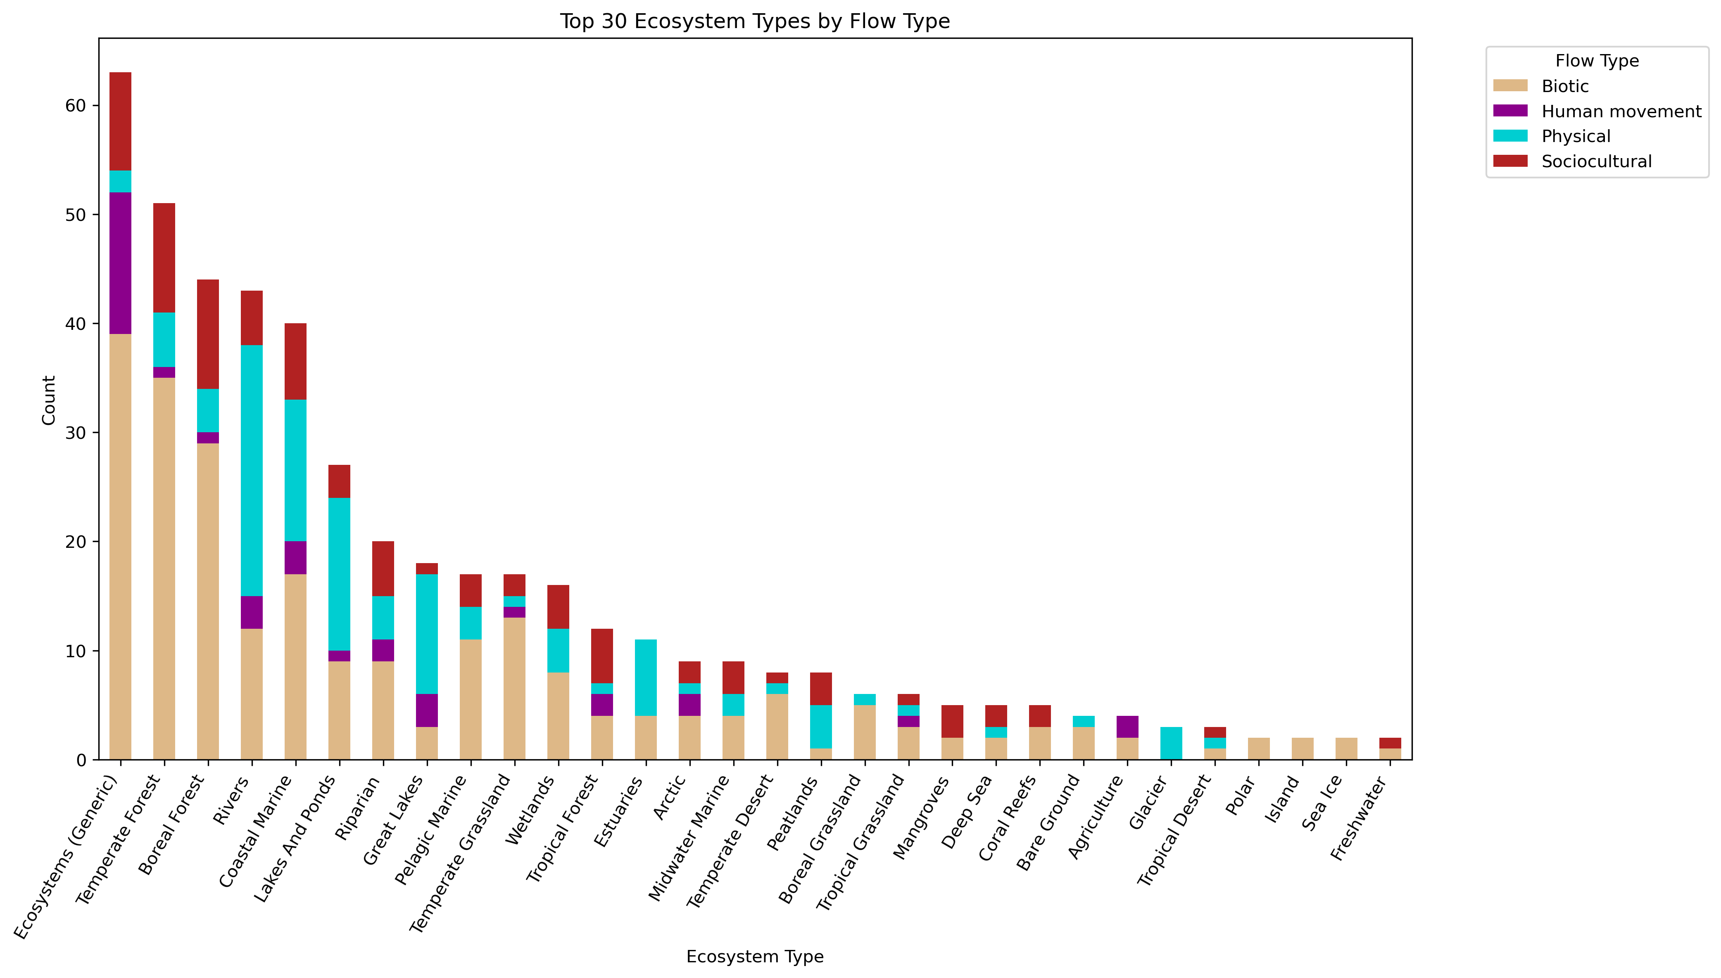

Slide 6
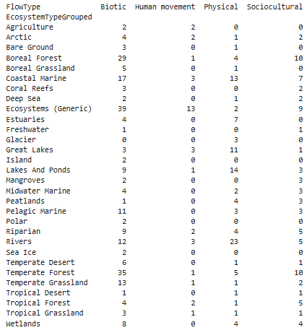
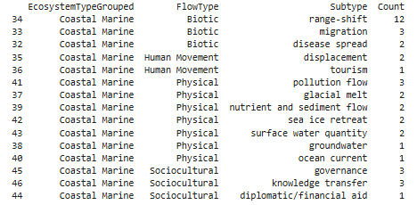

Slide 8
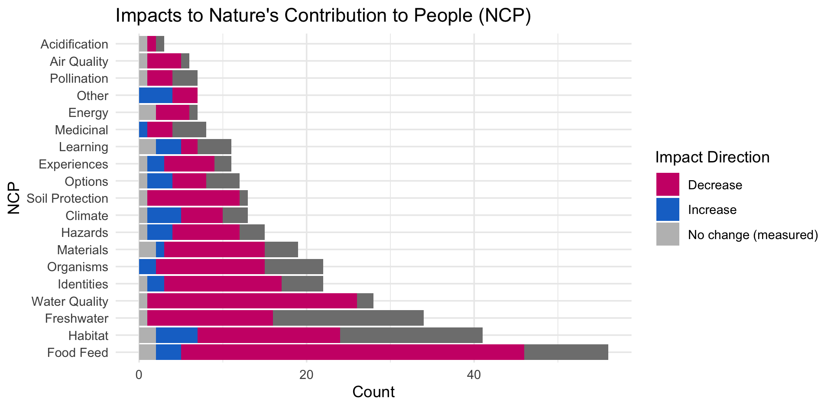

Slide 10
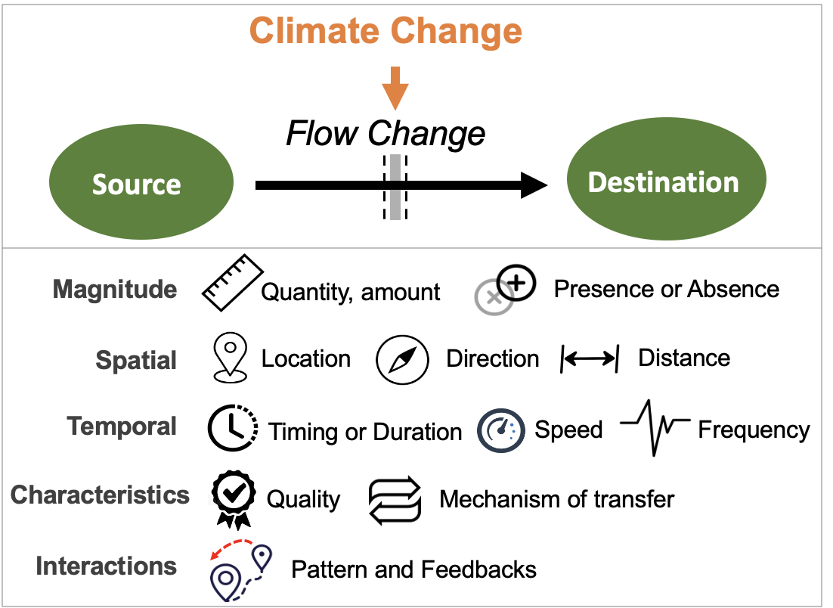
Most common paths
Climate change →

Slide 11
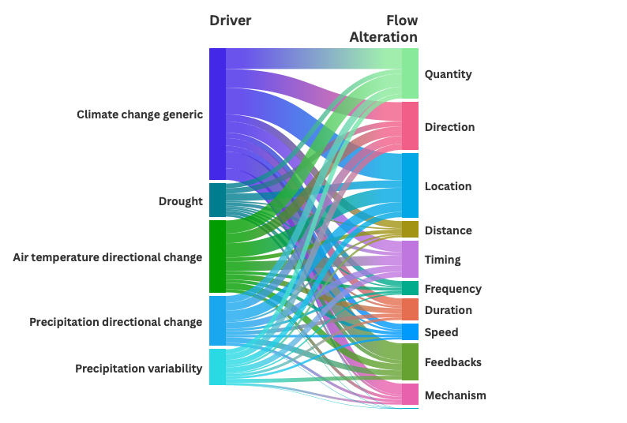

Slide 12
HWB studies count
# Cohesion Justice Other Relational Welfare
# 18 21 7 31 76

Slide 13
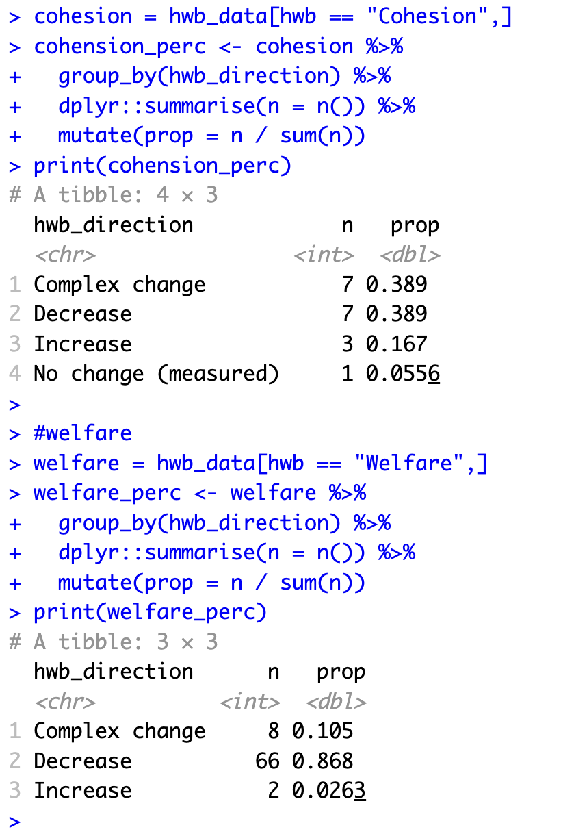
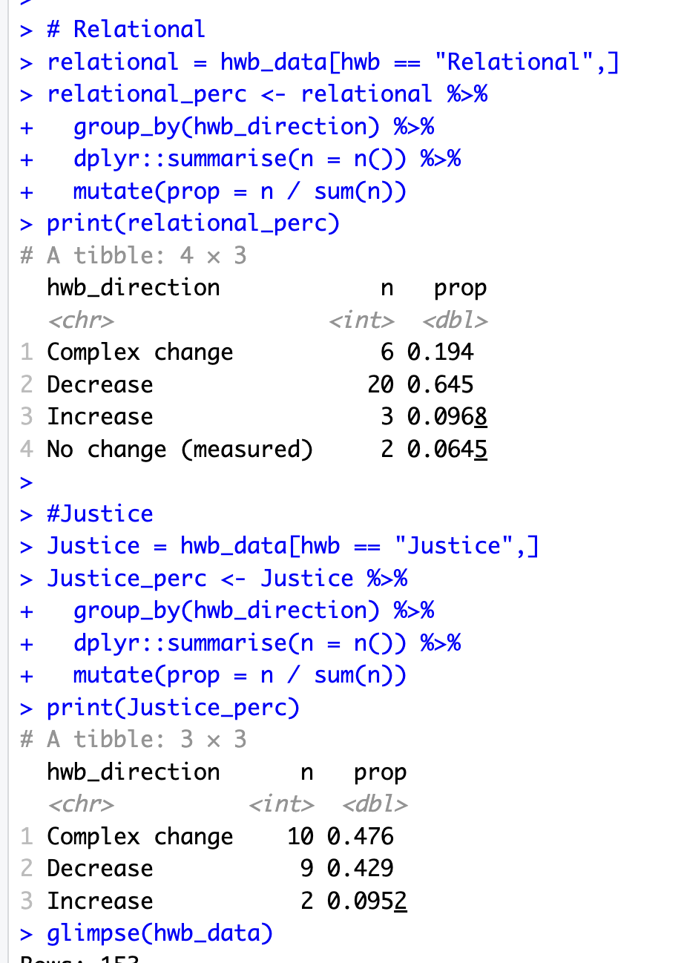

Slide 14
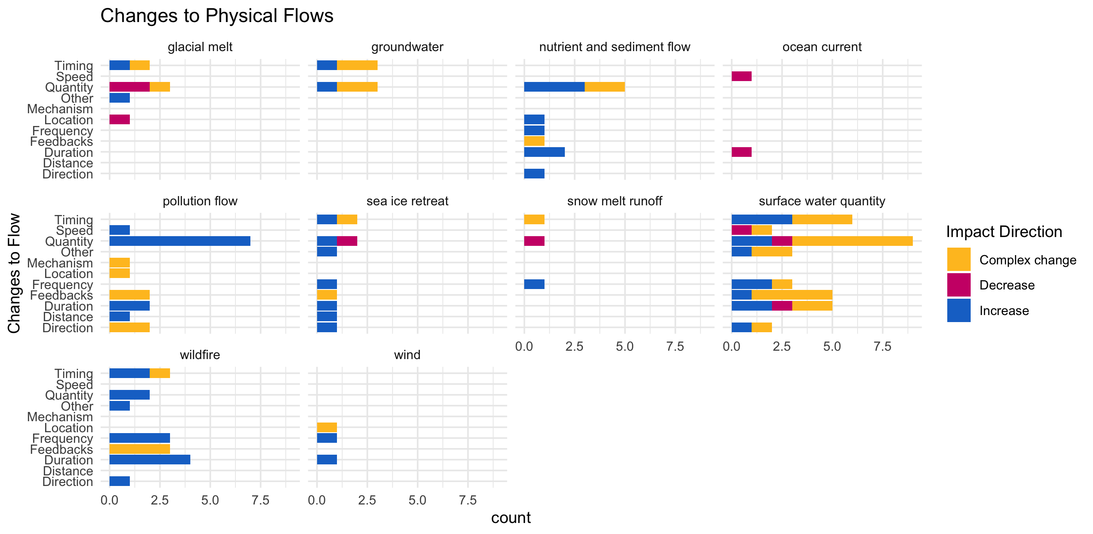

Slide 15
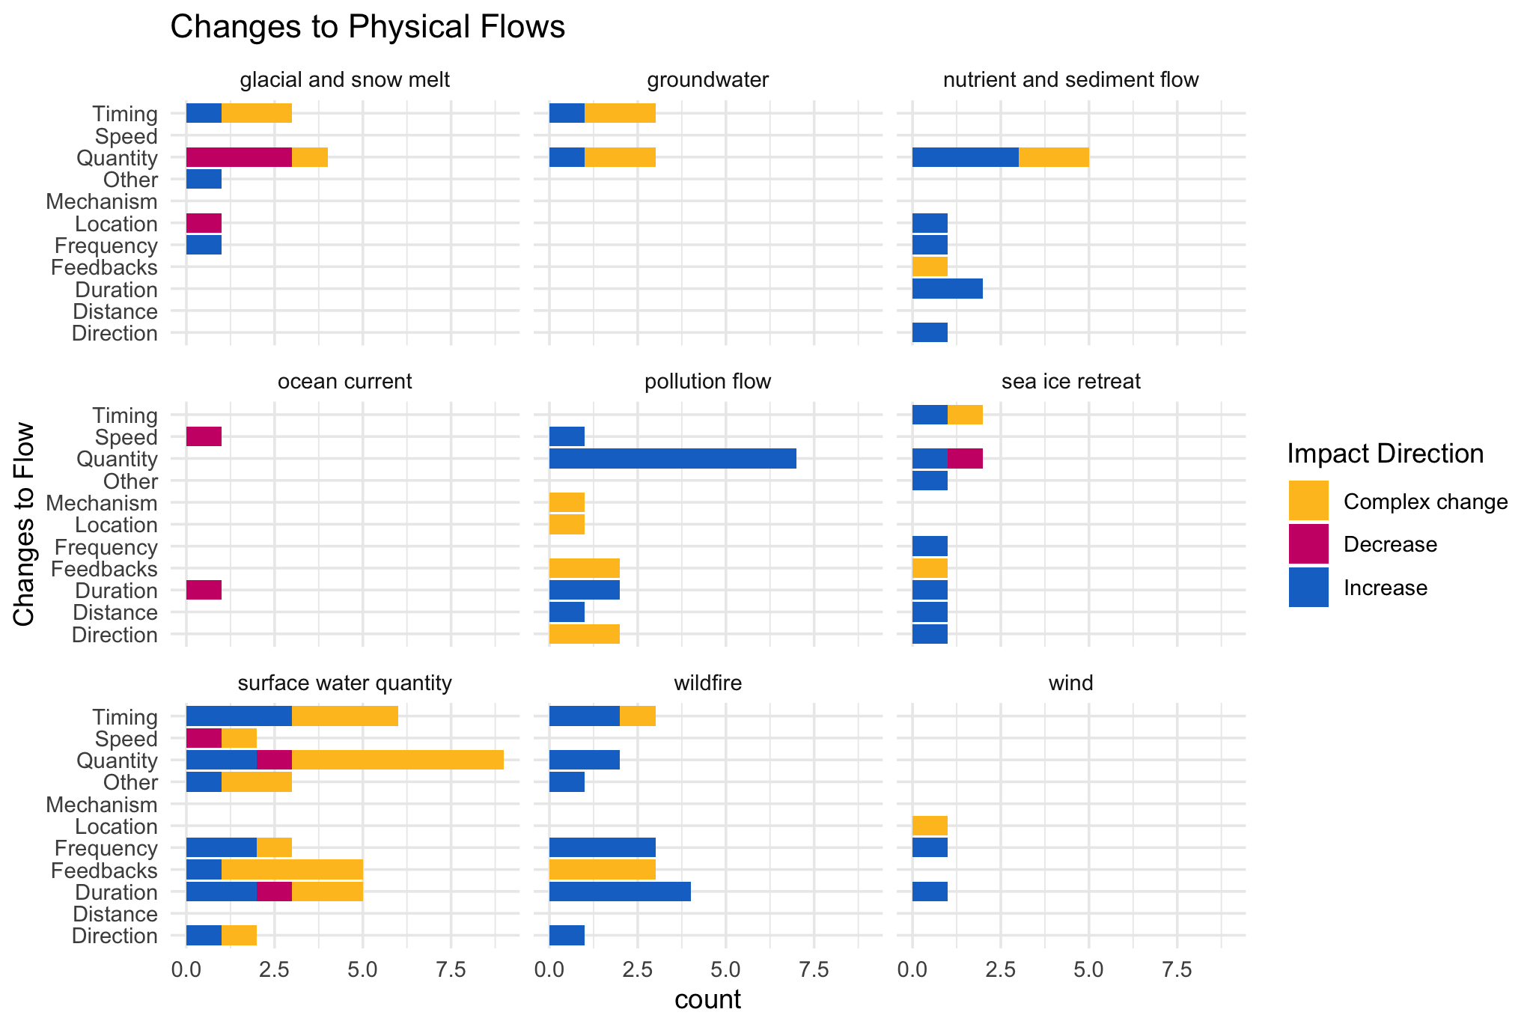

Slide 16
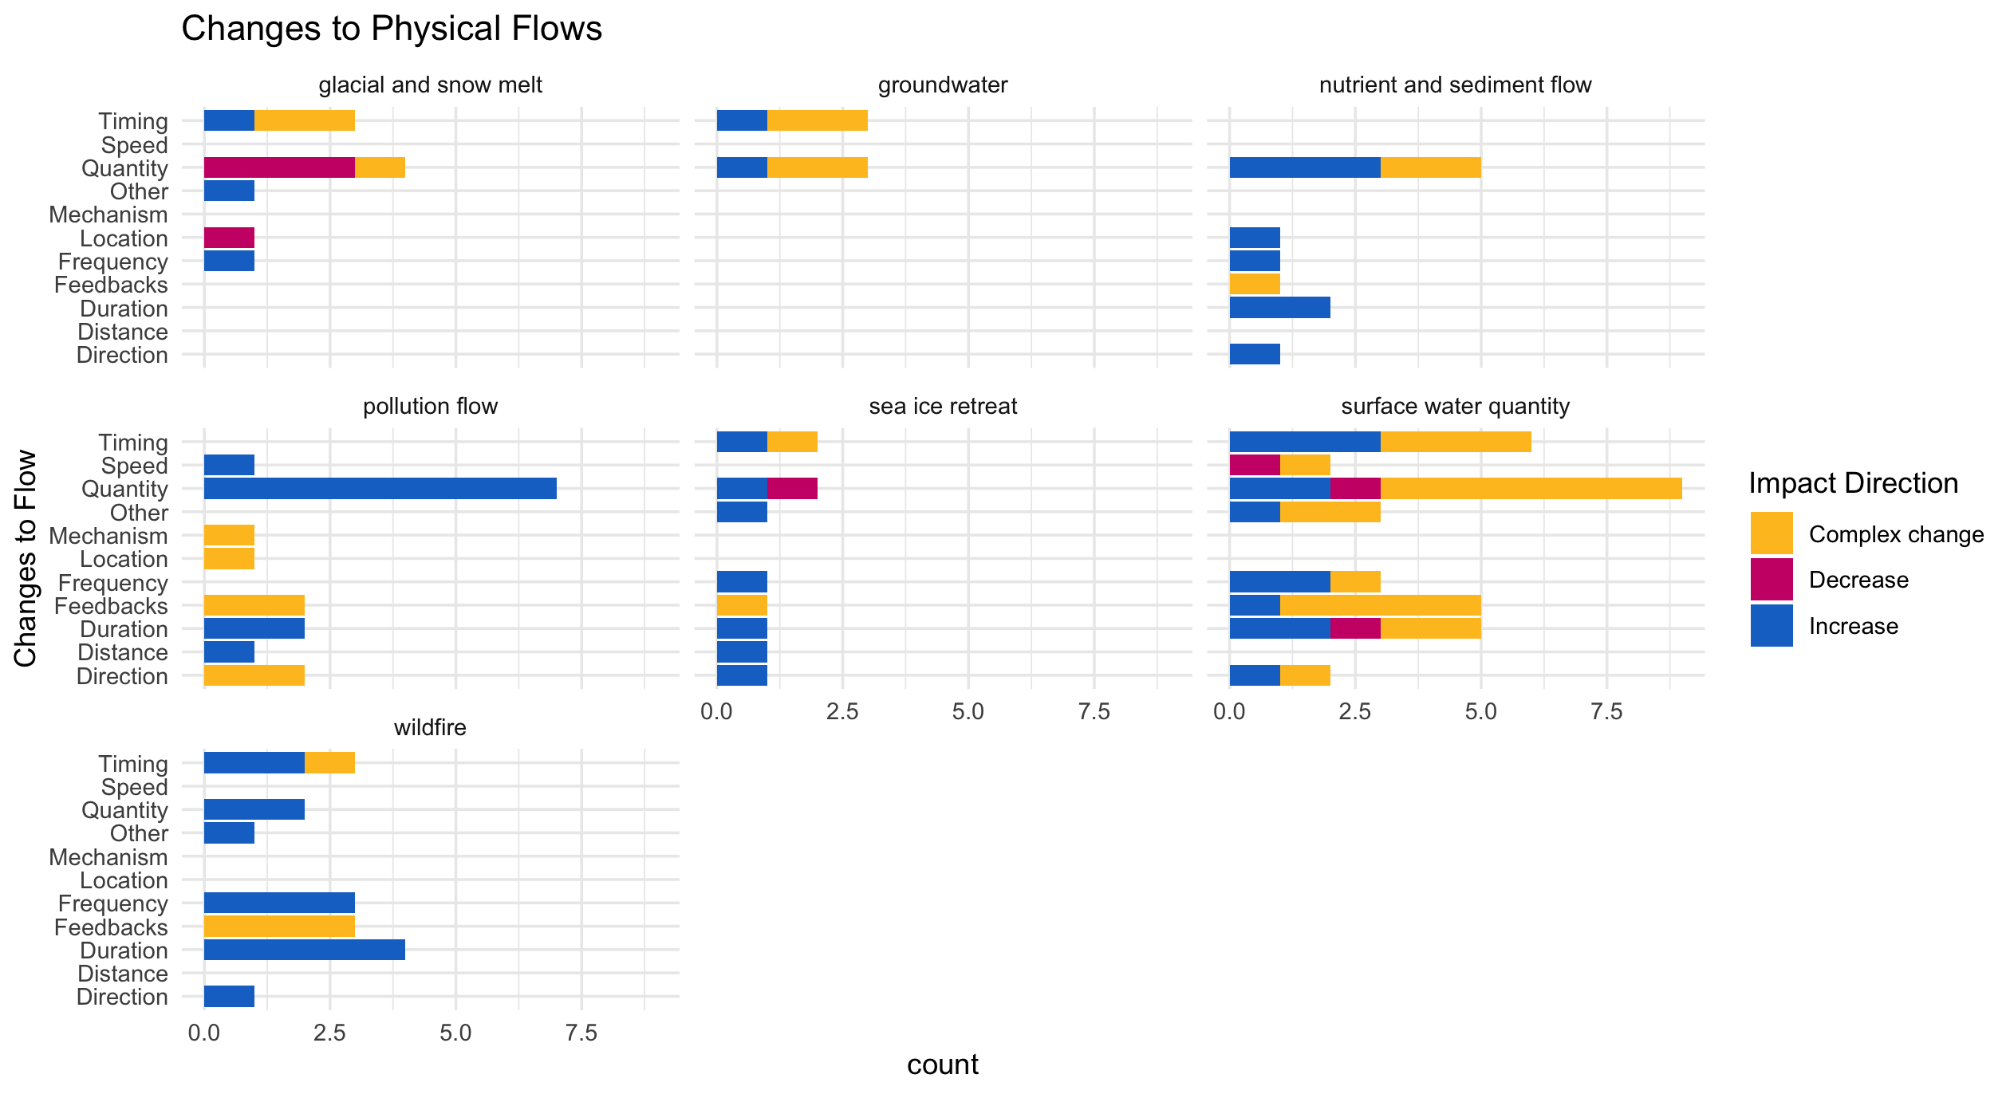

Slide 17
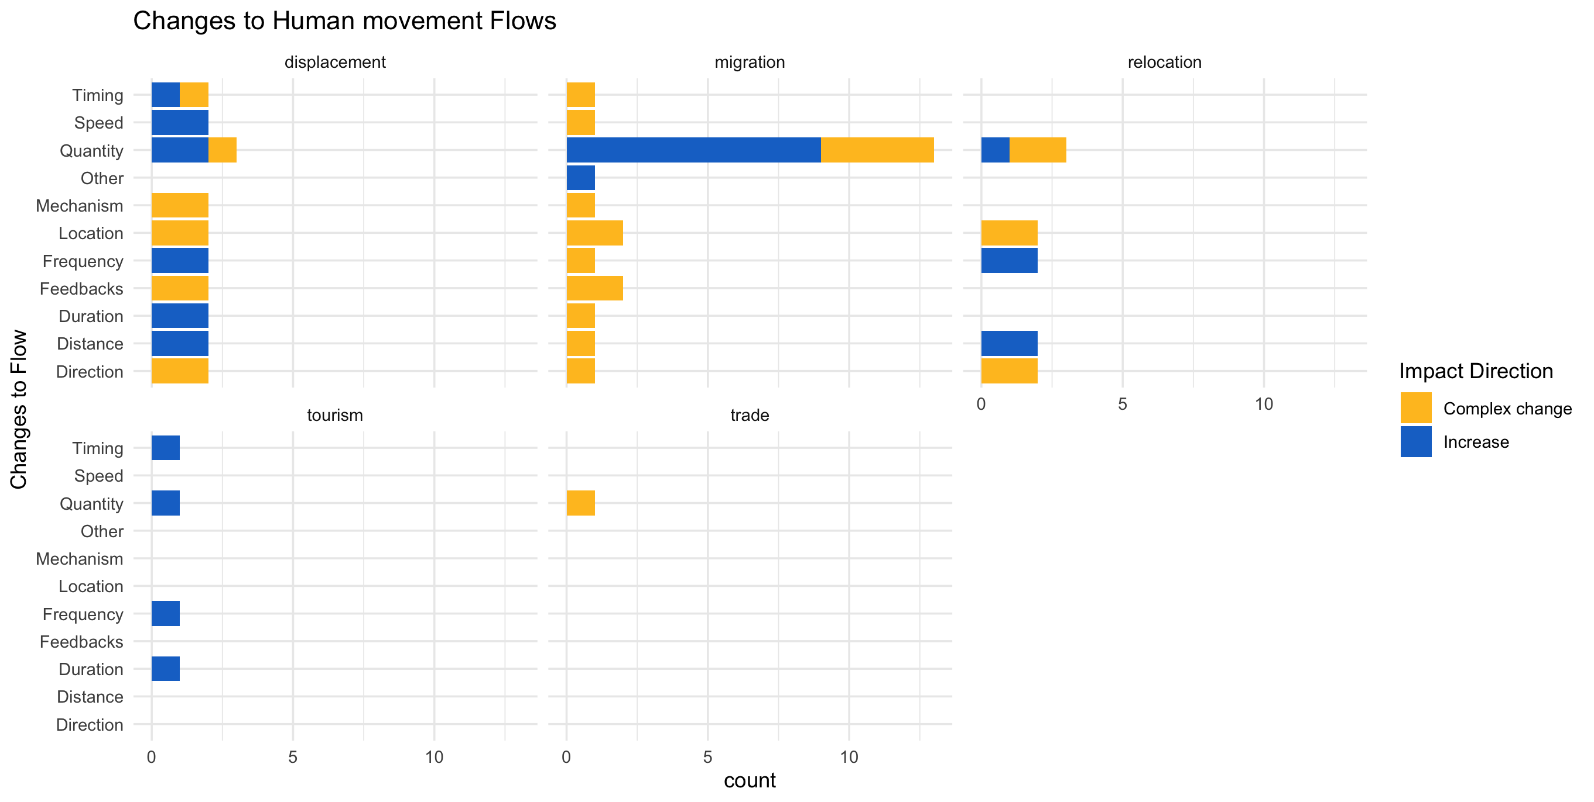

Slide 18
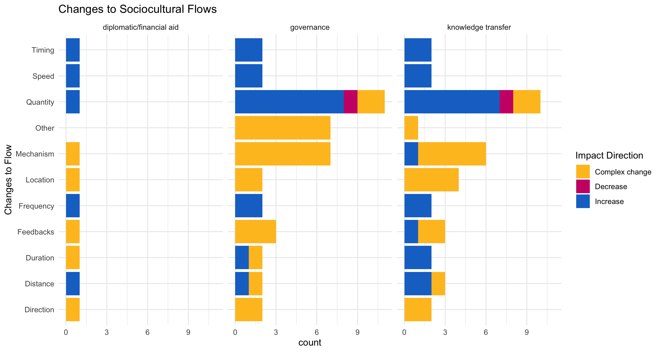

Slide 19
hwb_direction n prop
<chr> <int> <dbl>
1 Complex change 8 0.105
2 Decrease 66 0.868
3 Increase 2 0.0263

Slide 20
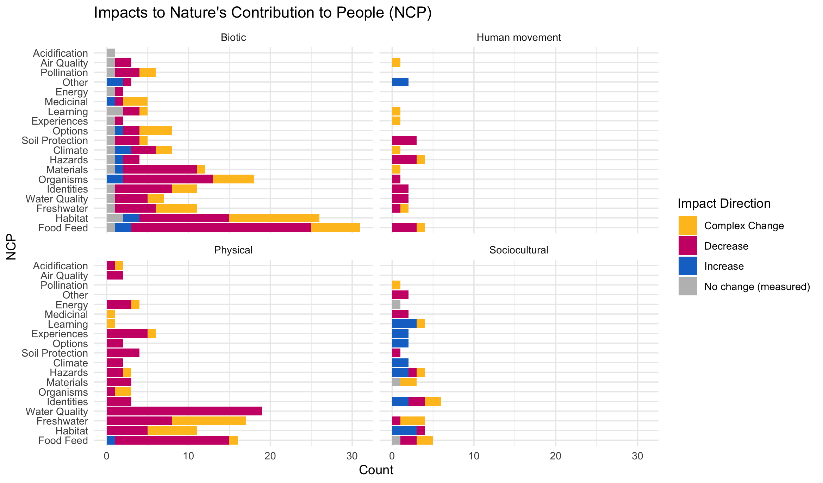

Slide 21
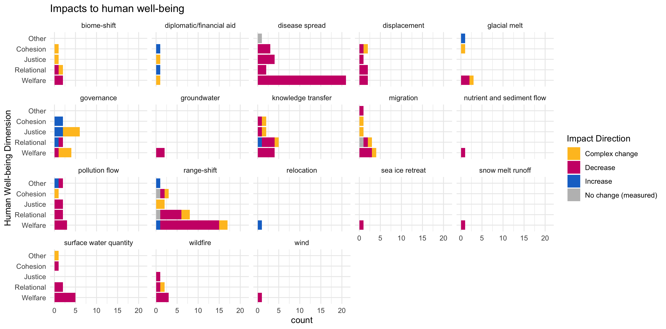

Slide 22
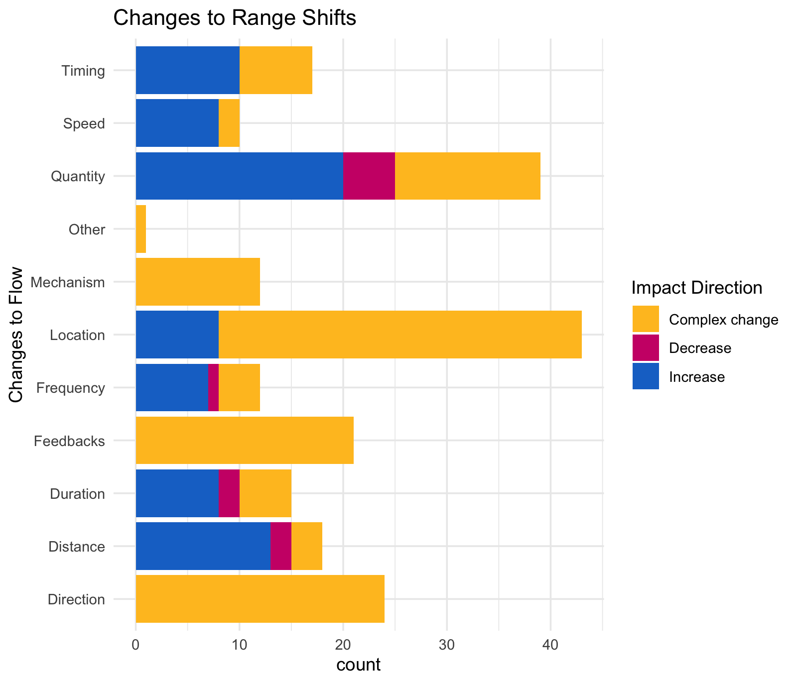

Slide 23
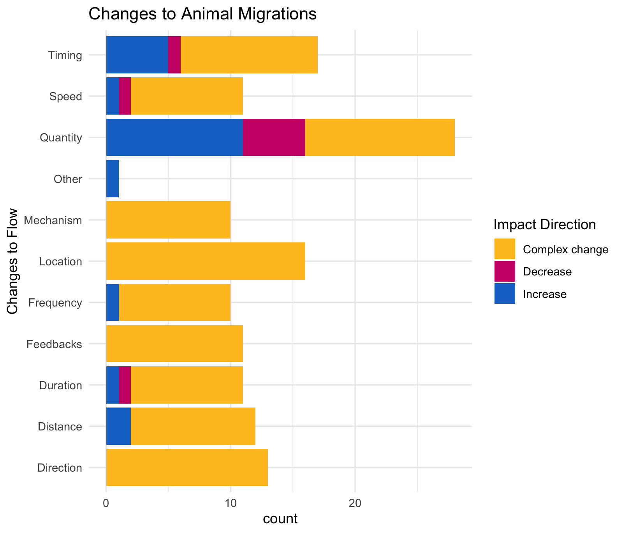

Slide 24
OLDER:

Slide 26
At least 5 entries – top – to get stats on % of entries or papers on these:

Slide 27
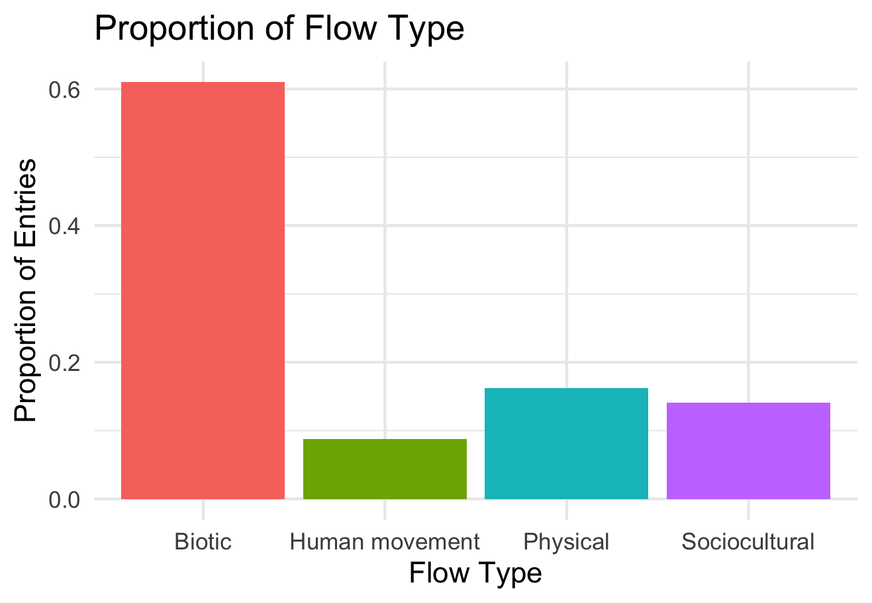

Slide 28
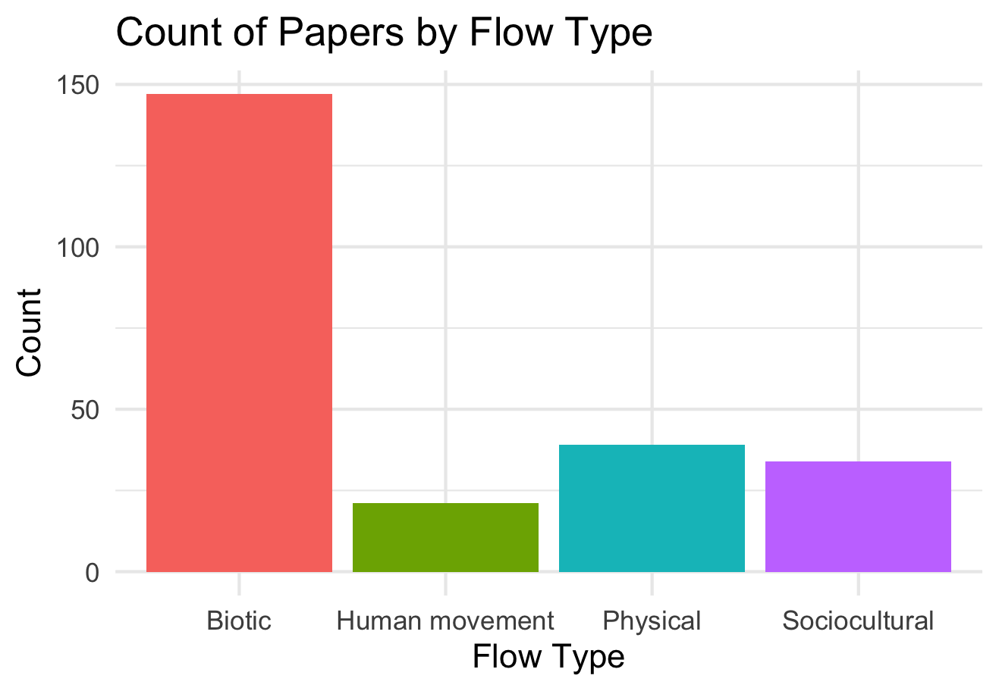

Slide 29
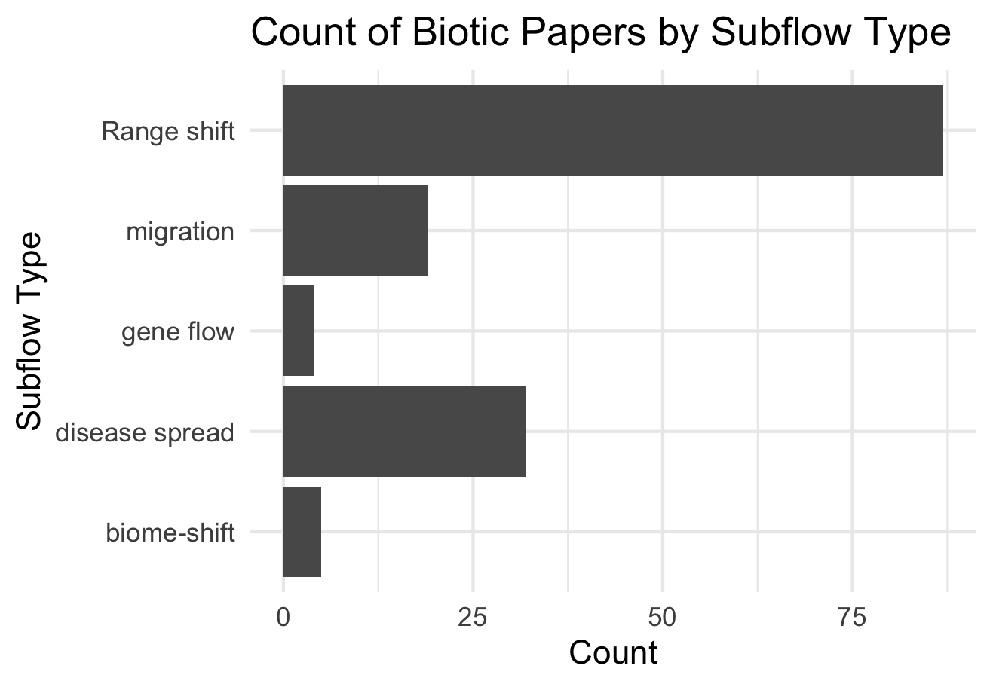

Slide 30
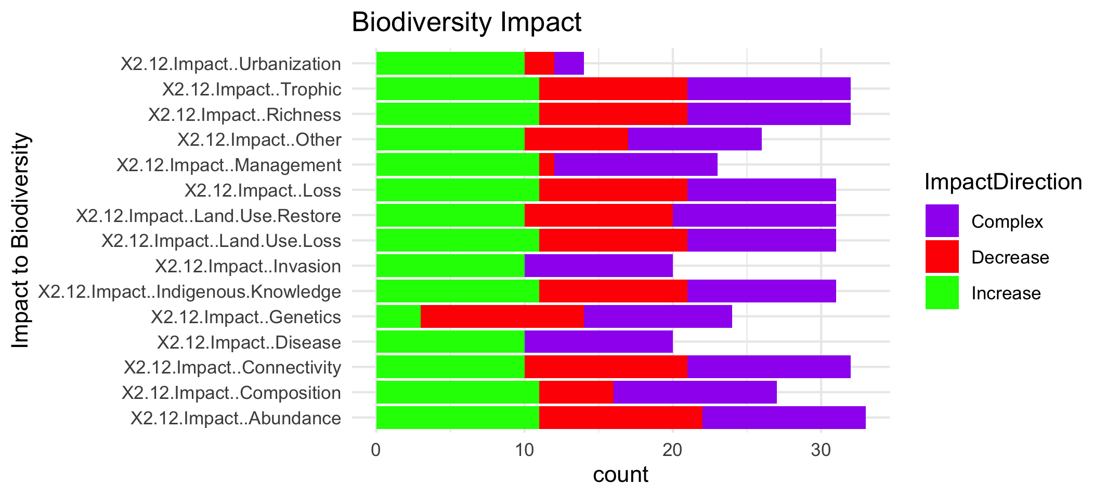

Slide 32
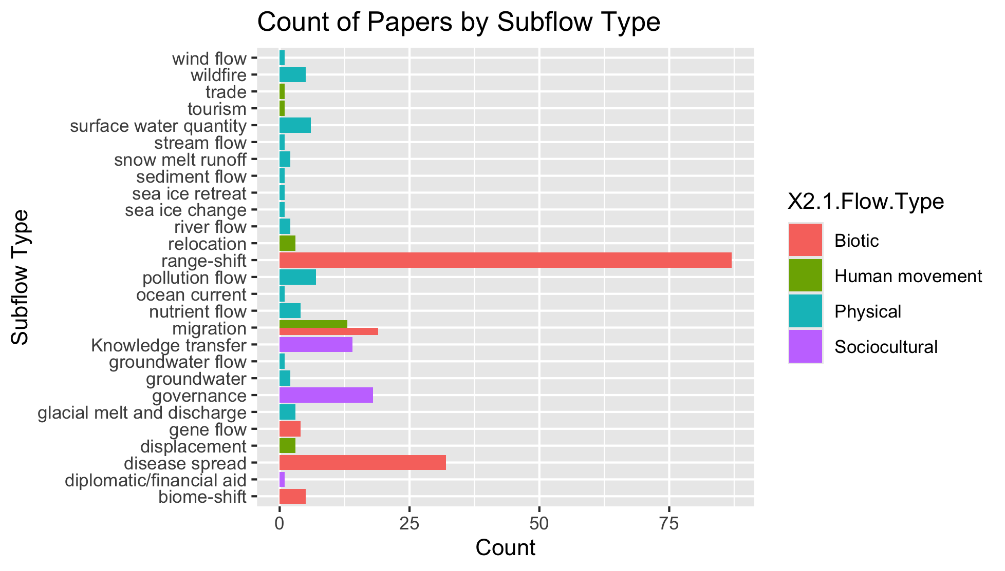
To group physical flow papers

Slide 33
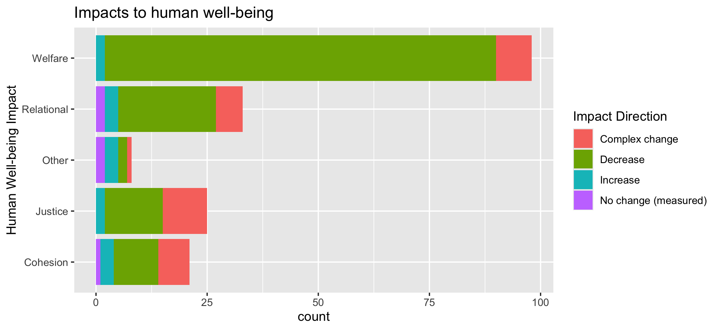
To align direction colors with final color pallet

Slide 34
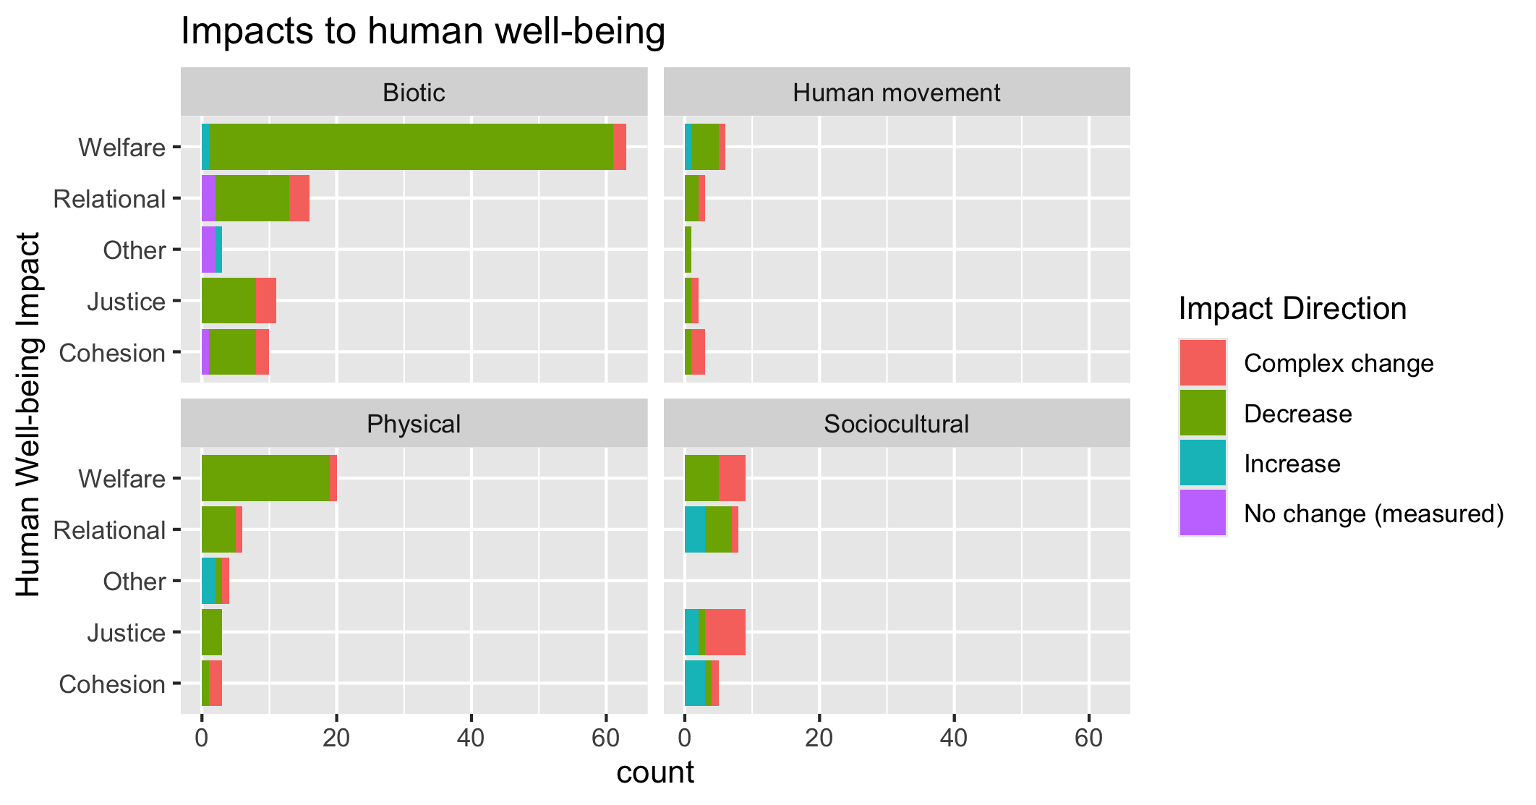
To align direction colors with final color pallet

Slide 35
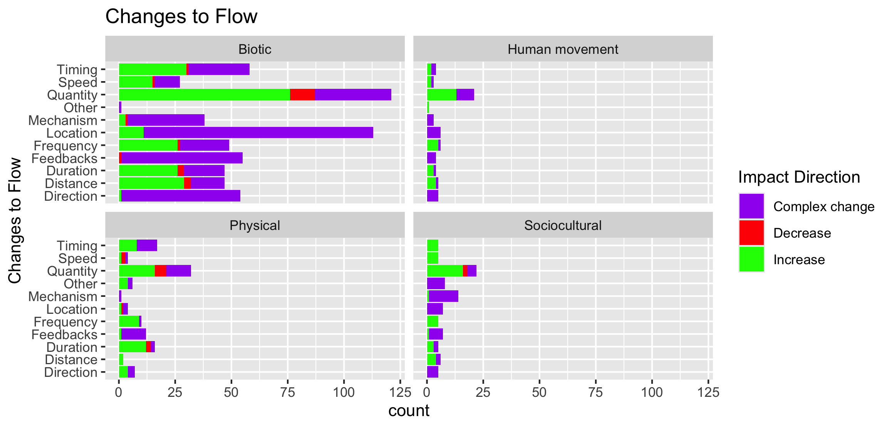

Slide 36
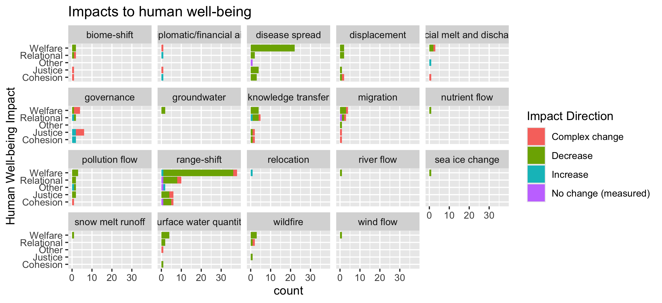
To group physical flow papers

Slide 37
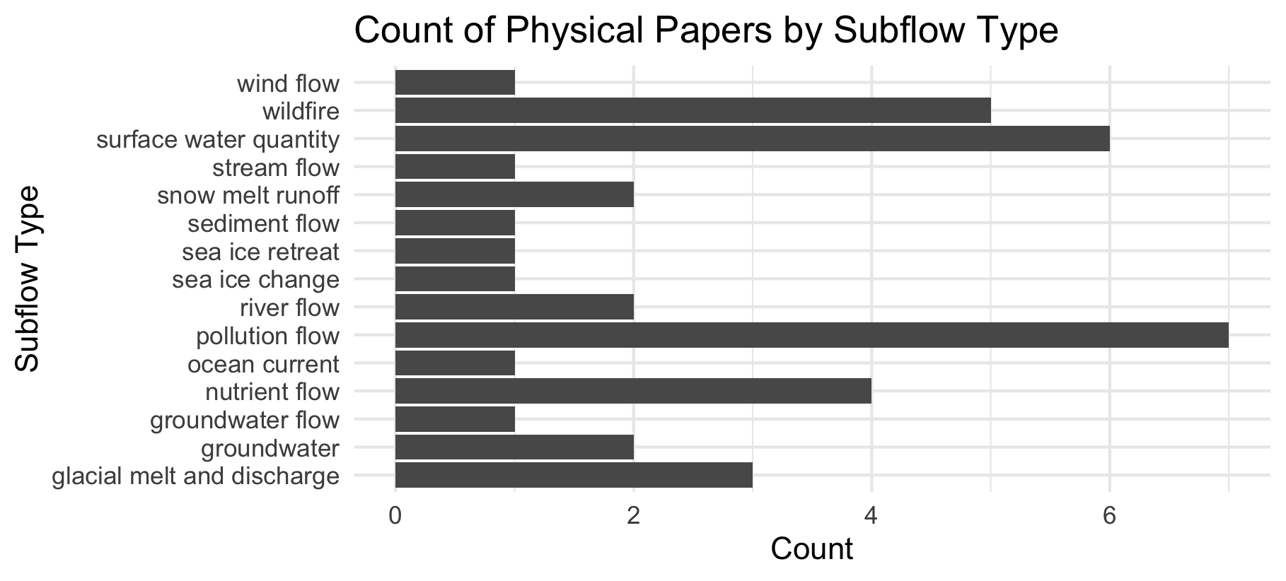

Slide 38
Feb 23 2025

Slide 39
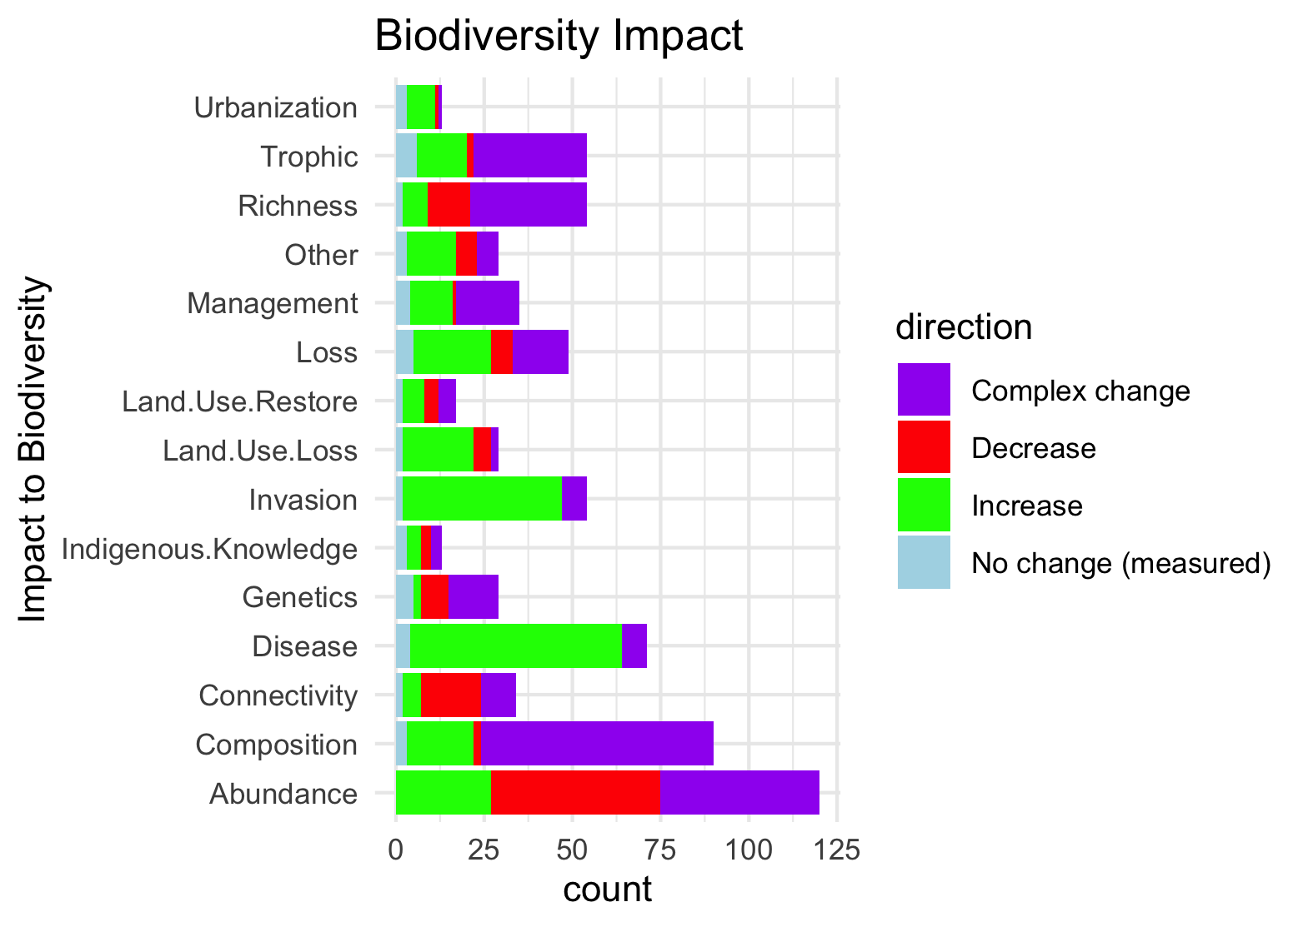
Needs to be grouped by what is good and what is bad to see increase in:

Slide 40
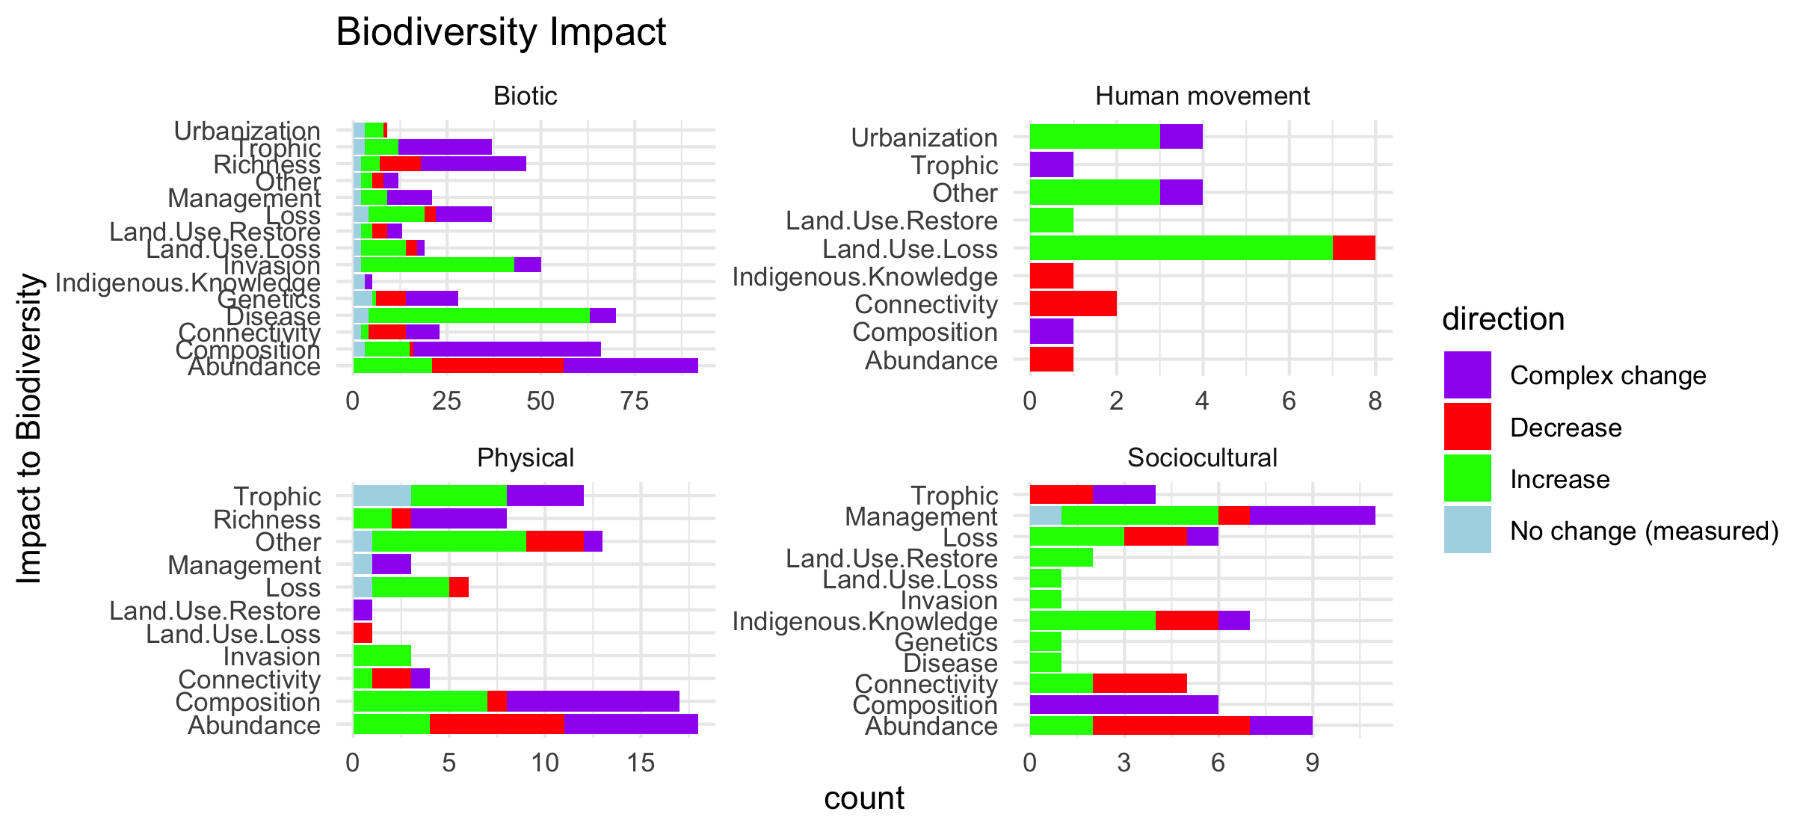
Scale free on the facet (diff x axis)

Slide 41
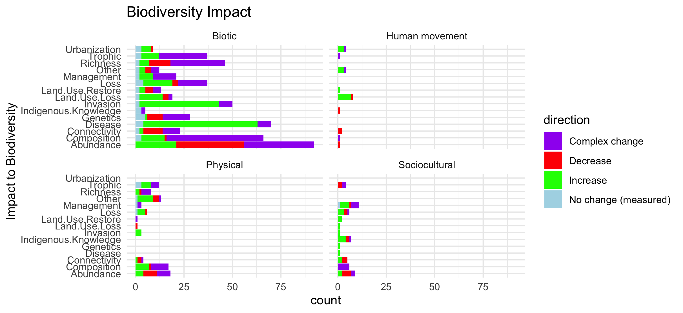
Scale fixed on the facet (same x axis)

Slide 42
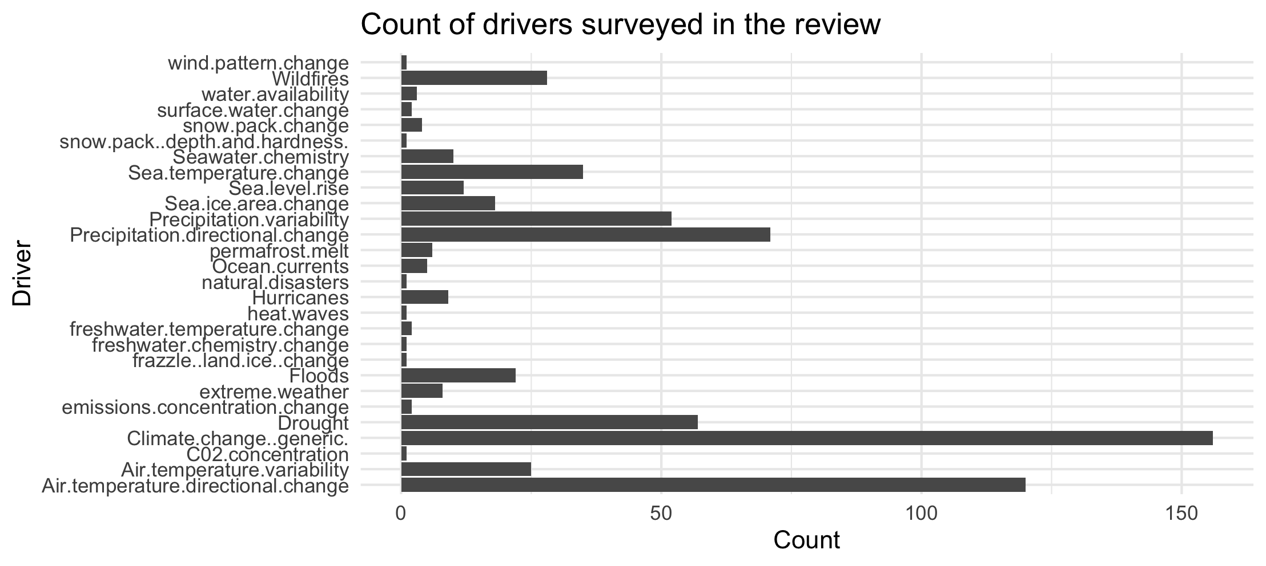

Slide 43
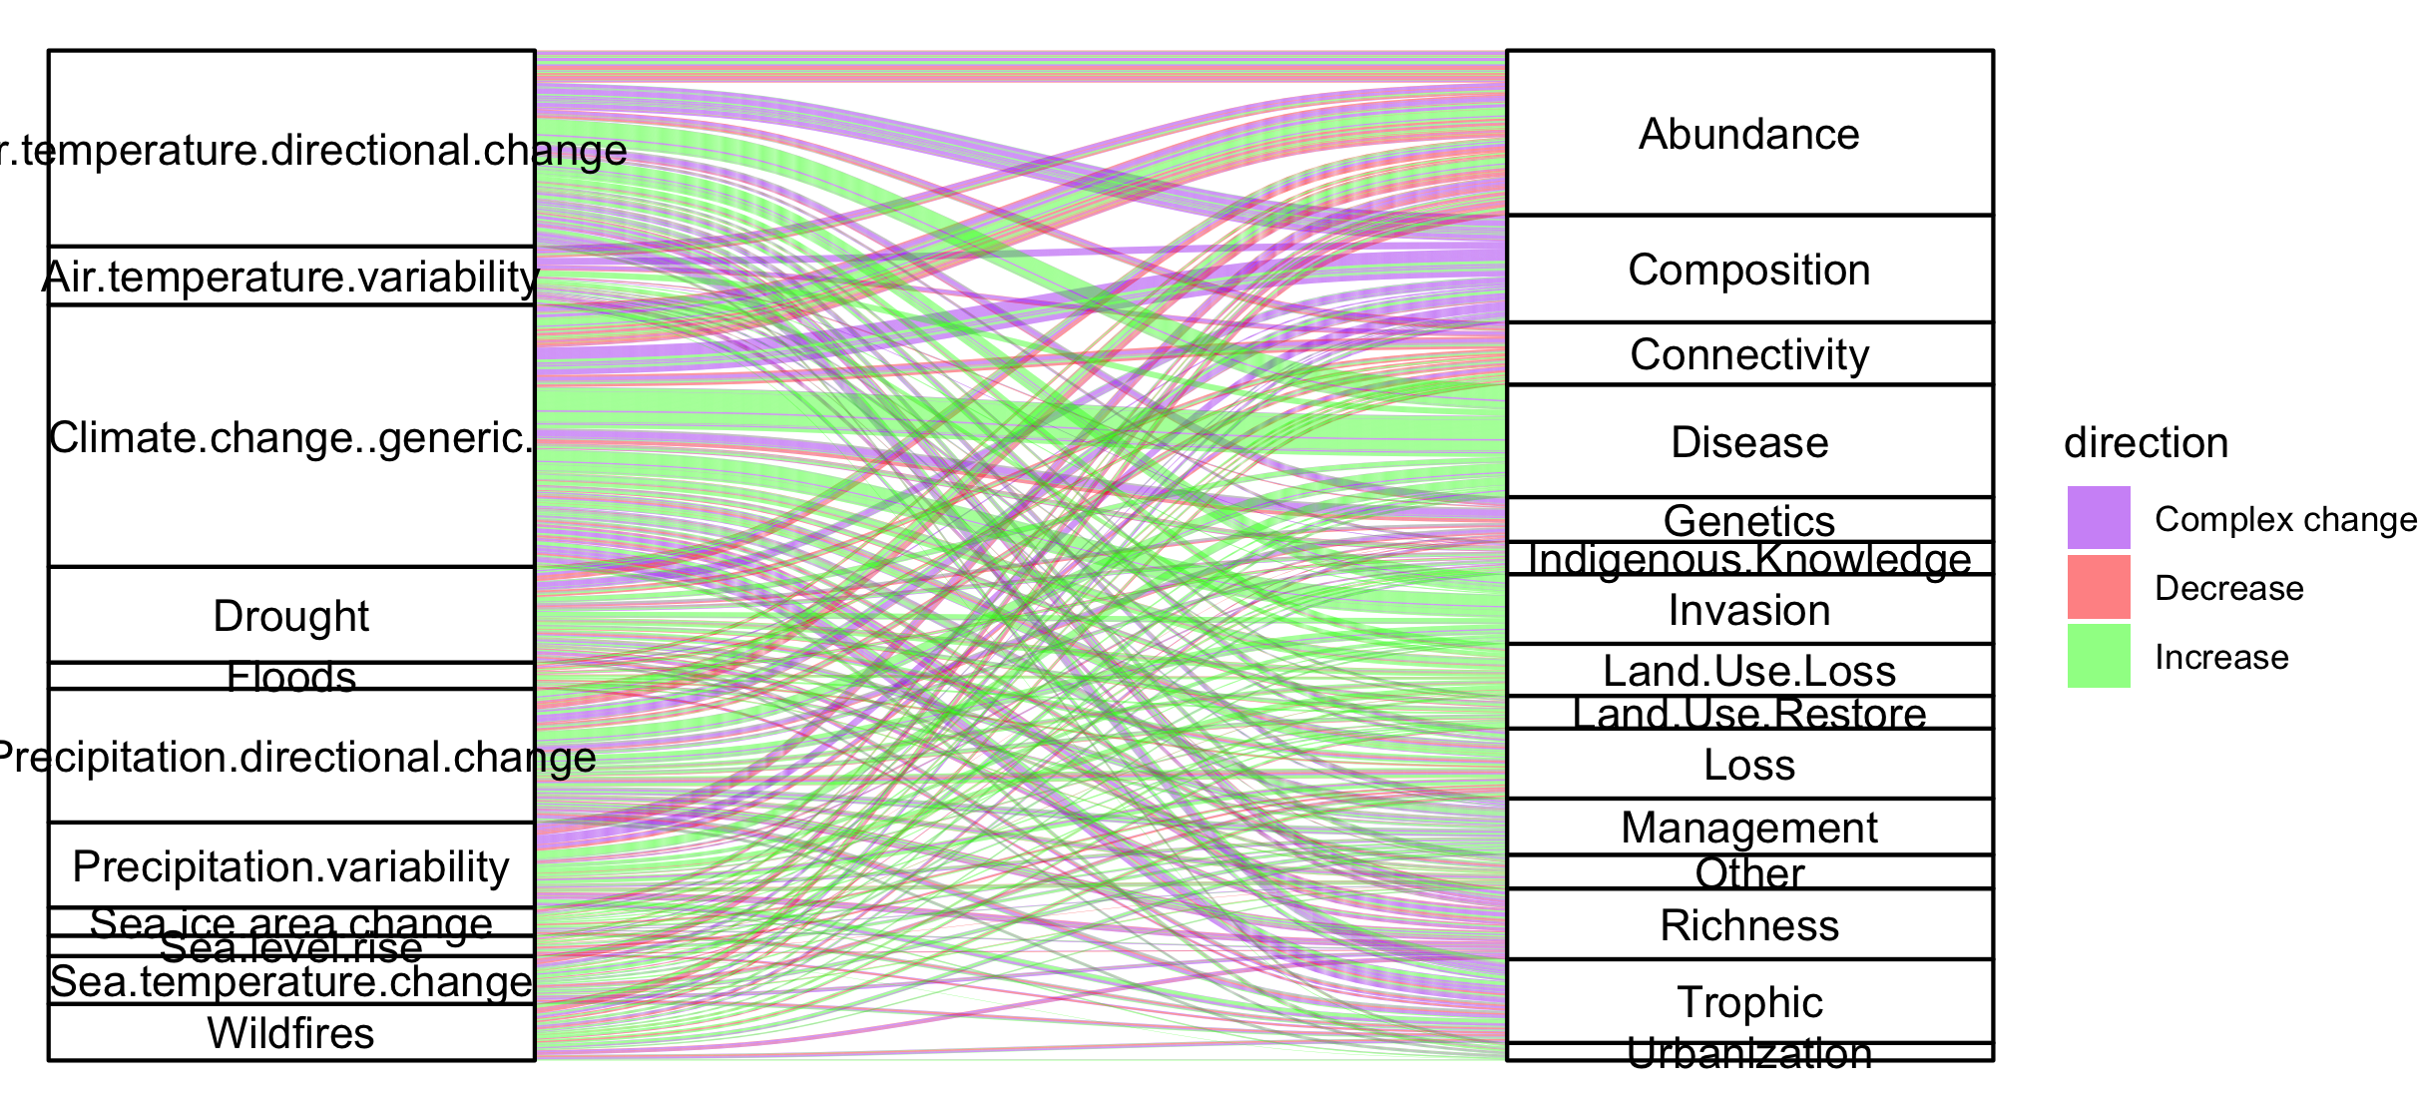
Colleen: see note isn the code – we could group spme of the drivers (hurricaines, extreme weather, ands ome of the ice ones). This still doesnt take into account if changes arw good or bad though and might just be too busy.

Slide 44
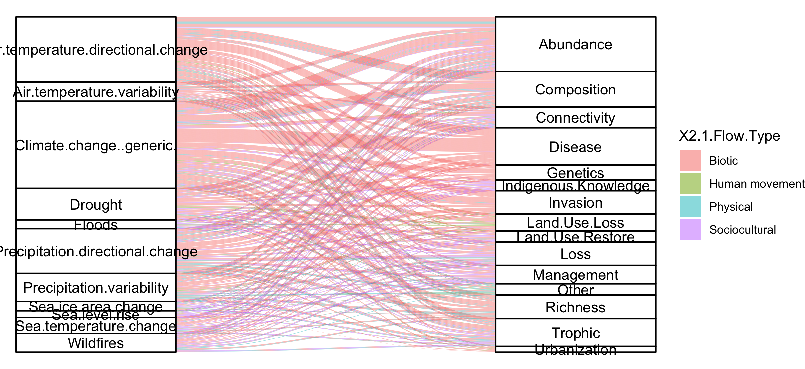
#not that informative because so many more of the papers are biotic

Slide 45
NCPs

Slide 46
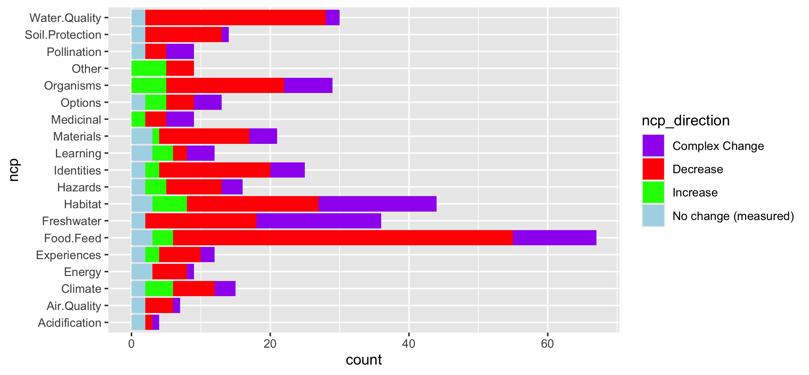
Fix labels

Slide 47
Do by flow type

Slide 48
Fix labels

Slide 49
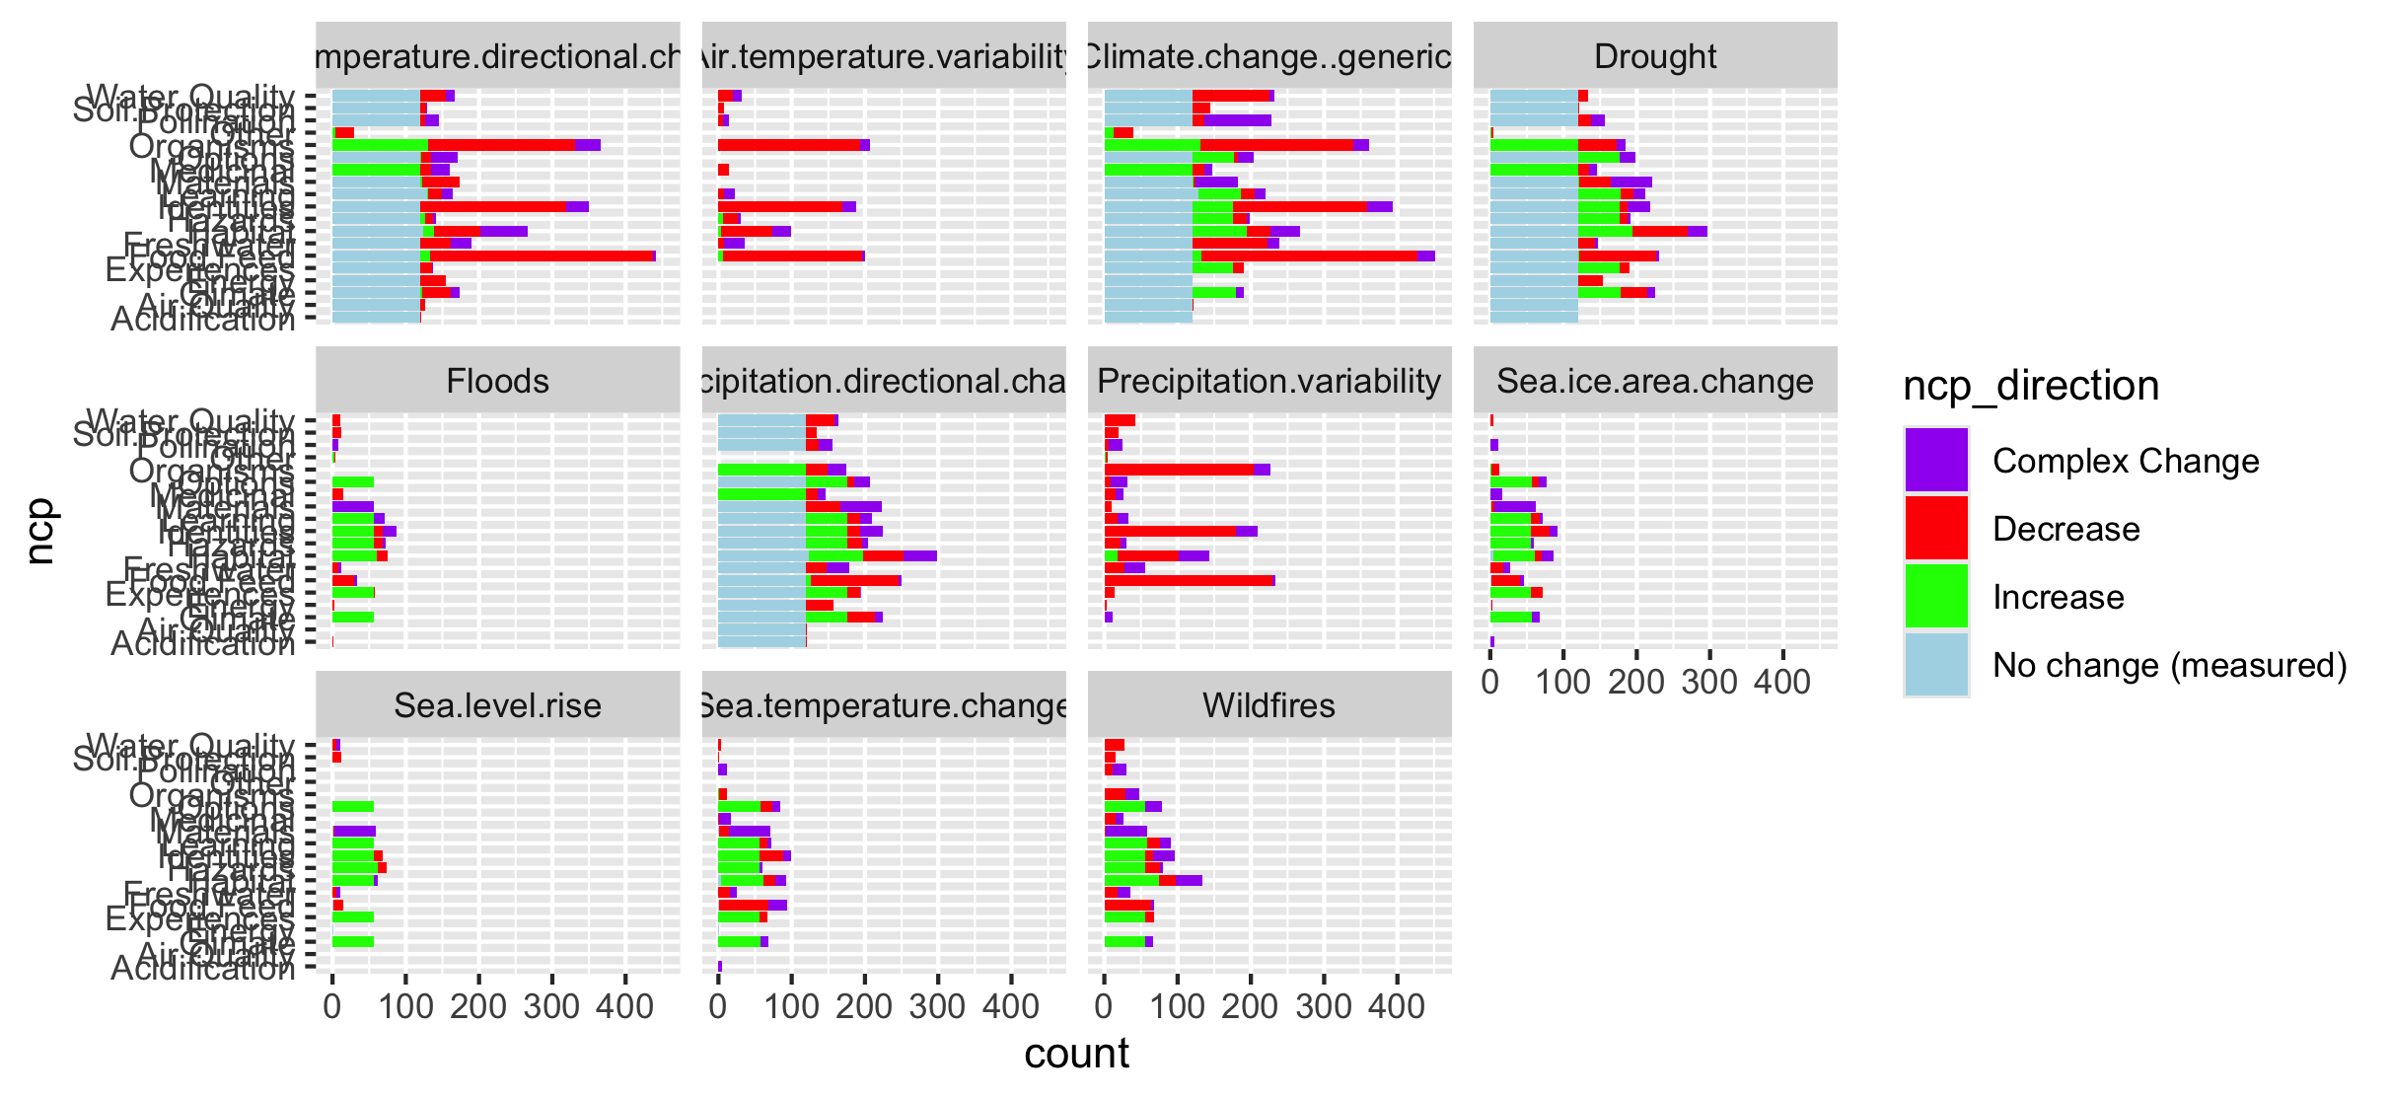

Slide 50
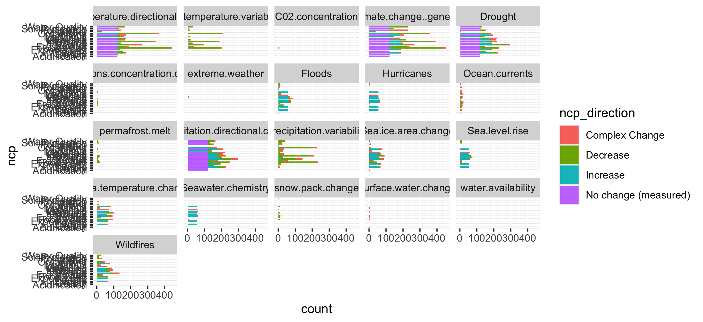
Too many drivers

Slide 51
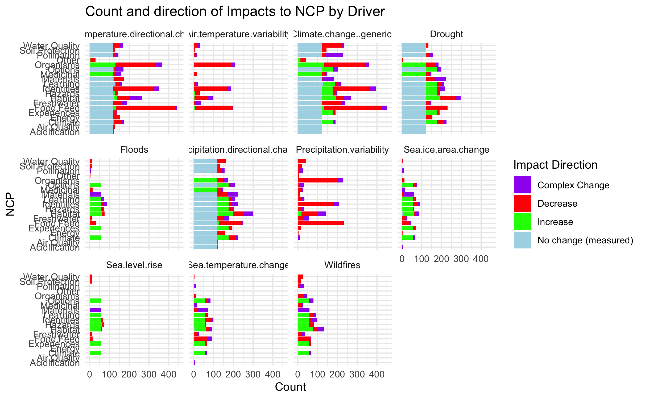

Slide 52
HWB

Slide 53
Connections – how does altered flow relate
Driver~ altered flow (by flow, and subflow – grouped out by flow
Altered flow~ impact (for each category)

